Slide 1
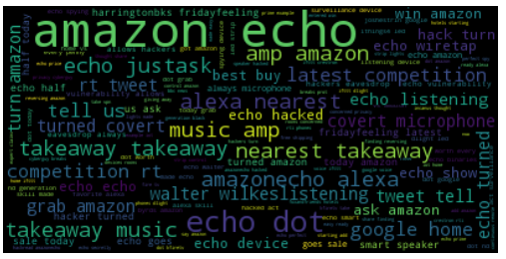
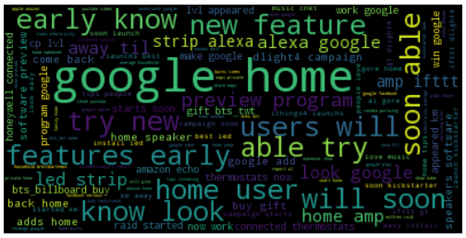
Word Cloud

Slide 2











Data Architecture: Prototype to Production
 | Data collection
 | Data storage
 | Data processing
 | Data analysis
 | Data visualization

